Slide 1



How Online Shopping is Reshaping Activity Patterns
Modeling Activity Behavior using Discrete Continuous Models
Dr. Katie Asmussen
Assistant Research Professor
University of Tennessee, Knoxville (UTK)
MOMO2025

Slide 2

Collaborator
Dr. Usman Ahmed
Assistant Research Professor
at UTK

Slide 3
# of online shoppers has surged in the past decade
10%
Every day
24%
More than once
a month
32%
At most once a month
or not at all
23%
Several times a week
76%
At most once a month
or not at all
25%
Once a week
In 2014
In 2024
Nanji, 2015; Caesar, 2024

Slide 4

On average, Americans spend
~30 minutes per day shopping online
~54 hours per year browsing online
Caesar, 2024; Melore, 2024

Slide 5





On-the-go and flexible ordering frees time for other activities, reshaping
people structure their day.

Slide 6





Online shopping has ripple effects on everyday routines, such as
At-Home Leisure
increases as browsing itself becomes a leisure activity
At-Home Maintenance
decreases with deliveries and meal kits replacing chores
In-Person Shopping
shifts in role. Used for comparisons before purchasing online
Outside-of-Home Leisure
increases as online shopping frees time for recreation
Outside-Home Maintenance
decreases due to curbside pickup and same-day delivery

Slide 7

Study
Objectives
Assess who shifts from in-person to online shopping?
Evaluate how online shopping reshapes in-person shopping, leisure, and chores
Analyze behavioral shifts from 2013 to 2023
Notes:
Addressing these questions requires a framework that captures the full spectrum of time allocation and its evolution under digital disruption over the past decade.
The policy and planning relevance in answering these questions is significant. For transportation professionals, understanding minute-level time-use trade-offs is essential to forecasting changes in in-store retail demand, parking infrastructure needs, vehicle miles traveled (VMT), and last-mile delivery patterns.
Urban planners and land-use regulators must consider how shrinking foot traffic in retail corridors interacts with growing demand for micro-fulfillment centers, parcel lockers, and compact logistics hubs.
Retailers can leverage these insights to craft omnichannel strategies that align with consumers’ evolving time budgets.
Telework policies and employer‐sponsored digital-wellness programs can be designed to help workers balance screen-based shopping with restorative breaks.
From a sustainability perspective, shifting environmental burdens from personal travel to delivery logistics calls for holistic assessments that integrate time-use and emissions modeling.

Slide 8
Study
Objectives
Assess who shifts from in-person to online shopping?
Evaluate how online shopping reshapes in-person shopping, leisure, and chores
Analyze behavioral shifts from 2013 to 2023
Notes:
Addressing these questions requires a framework that captures the full spectrum of time allocation and its evolution under digital disruption over the past decade.
The policy and planning relevance in answering these questions is significant. For transportation professionals, understanding minute-level time-use trade-offs is essential to forecasting changes in in-store retail demand, parking infrastructure needs, vehicle miles traveled (VMT), and last-mile delivery patterns.
Urban planners and land-use regulators must consider how shrinking foot traffic in retail corridors interacts with growing demand for micro-fulfillment centers, parcel lockers, and compact logistics hubs.
Retailers can leverage these insights to craft omnichannel strategies that align with consumers’ evolving time budgets.
Telework policies and employer‐sponsored digital-wellness programs can be designed to help workers balance screen-based shopping with restorative breaks.
From a sustainability perspective, shifting environmental burdens from personal travel to delivery logistics calls for holistic assessments that integrate time-use and emissions modeling.

Slide 9

Survey and Dataset
2013 and 2023 versions of the American Time Use Survey
24-hour time-use diary
Minutes spent:
Online shopping
In-person shopping
At-home leisure activities
Outside-of-home leisure activities
At-home maintenance activities
Outside-of-home maintenance activities
Final sample size: x
10,816 2013 respondents
8,251 2023 respondents
19,067 total respondents

Slide 10
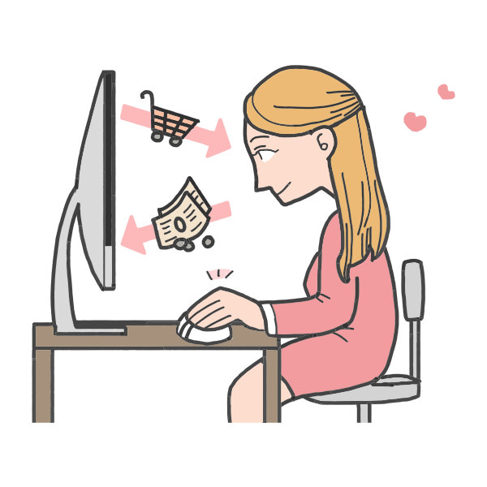
Model and Estimation
Multiple Discrete Continuous (MDC) model by Palma and Hess (2008)
Capture both the choice to engage and the time spent
Model decade shifts with year-based interaction terms
Estimates complementarity and substitution effects between activities

Slide 11
Model and Estimation
Multiple Discrete Continuous (MDC) model by Palma and Hess (2008)
Capture both the choice to engage and the time spent
Model decade shifts with year-based interaction terms
Estimates complementarity and substitution effects between activities
2013 2023

Slide 12
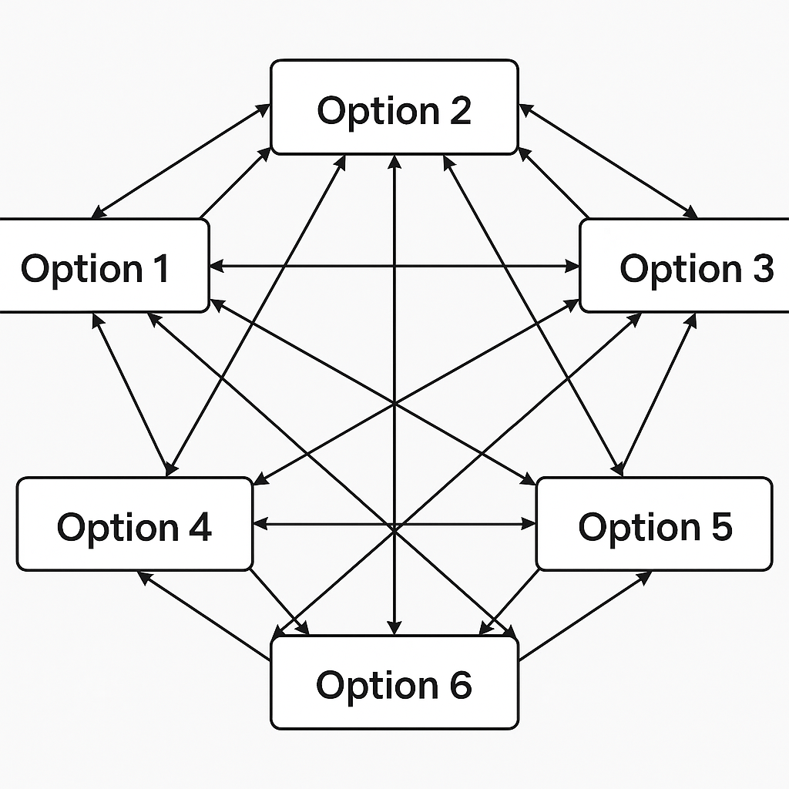
Model and Estimation
Multiple Discrete Continuous (MDC) model by Palma and Hess (2008)
Capture both the choice to engage and the time spent
Model decade shifts with year-based interaction terms
Estimate complementarity and substitution effects between activities

Slide 13
Ripple Effect of Daily Activities
In-Person Shopping
Online Shopping
At-Home
Maintenance
Complimentary
“MORE … may lead to MORE …”
Substitution
“MORE … may lead to LESS …”
Outside-of-Home
Leisure
Outside-of-Home
Maintenance
At-Home Leisure

Slide 14
Ripple Effect of Online Shopping on Daily Activities
In-Person Shopping
Online Shopping
At-Home
Maintenance
Complimentary
“MORE online shopping may lead to MORE …”
Substitution
“MORE online shopping may lead to LESS …”
Outside-of-Home
Leisure
Outside-of-Home
Maintenance
At-Home Leisure

Slide 15


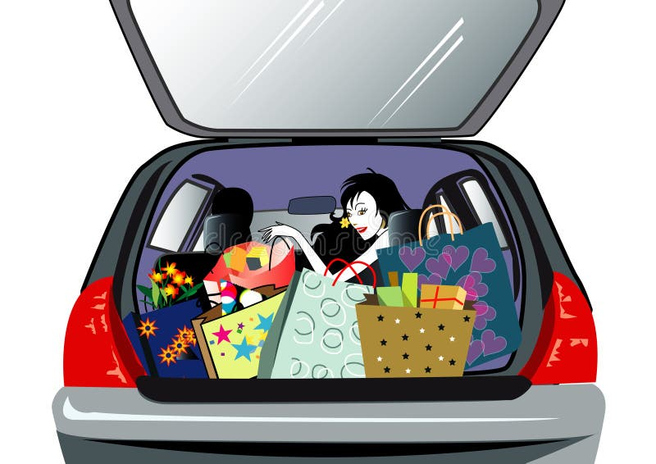

Ripple Effect of Online Shopping on Daily Activities
In-Person Shopping
Online Shopping
At-Home
Maintenance
Complimentary
“MORE online shopping may lead to MORE In-person shopping”
Omnichannel consumption patterns:
Outside-of-Home
Leisure
Outside-of-Home
Maintenance
Potentially shorter,
but more frequent in-person shopping trips
Accessible shopping within walking distance shopping
Browse online
Buy in store
At-Home Leisure
Notes:
Consumers may use online research to narrow choices, leveraging rich product information, reviews, and price comparisons, then visit stores to inspect, test, or immediately obtain goods. This two-step behavior reflects a complementary blend of utilitarian and hedonic motivations. By cutting search costs, browsing online likely makes each in-person visit more efficient and targeted, though it also often prompts shopping trips that might otherwise not occur.

Slide 16

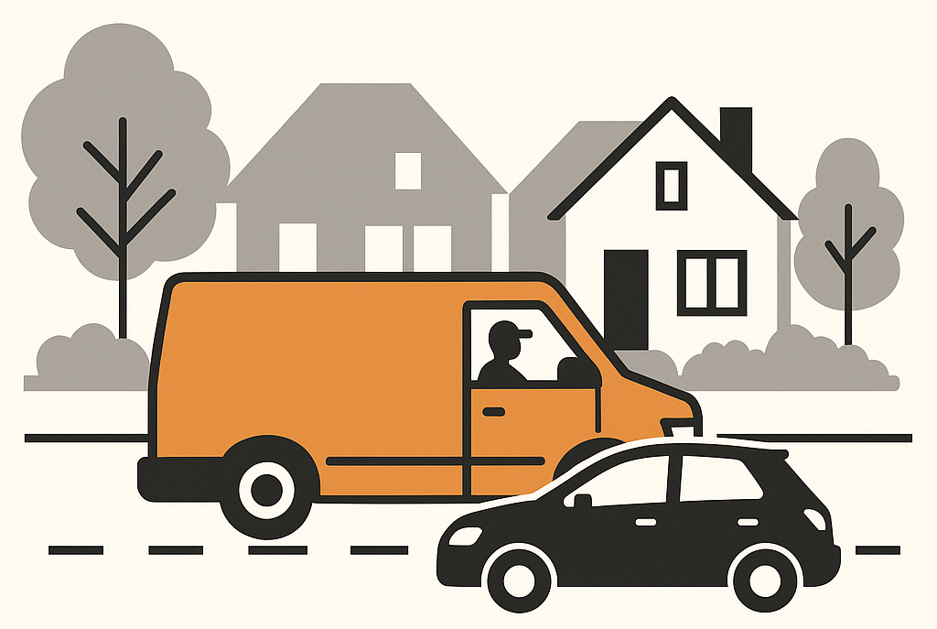

Ripple Effect of Online Shopping on Daily Activities
In-Person Shopping
At-home fun: gaming, streaming, and ordering food in
Online Shopping
More last-mile deliveries, creating curbside congestion in residential areas
Complimentary
“MORE online shopping may lead to MORE at-home leisure”
At-Home
Maintenance
Mandate off-peak delivery slots and provide loading zones for consolidation and cargo bikes
Substitution
“MORE online shopping may lead to LESS outside-of-home leisure”
Outside-of-Home
Leisure
Outside-of-Home
Maintenance
At-Home Leisure

Slide 17



Ripple Effect of Online Shopping on Daily Activities
In-Person Shopping
Online Shopping
At-Home
Maintenance
Substitution
“MORE online shopping may lead to LESS at-home and outside-of-home maintenance”
Meal kit deliveries & on-demand online services supplant cleaning, cooking, and routine errands activities
Outside-of-Home
Leisure
Outside-of-Home
Maintenance
Time savings reduce incidental physical activity
Community-wide “active domestic” initiatives
At-Home Leisure
Notes:
Time savings reduce incidental physical activity, adding to sedentary lifestyles (↑ ~2 hours daily sitting since the pandemic).
Communities can counter this with “active domestic” initiatives (e.g., clean-up drives, green home workshops).

Slide 18
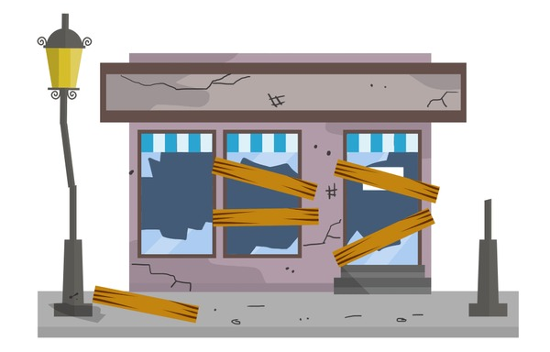

Ripple Effect of Online Shopping on Daily Activities
In-Person Shopping
Online Shopping
At-Home
Maintenance
Substitution
“MORE online shopping may lead to LESS at-home and outside-of-home maintenance”
Same-day delivery & curbside pickup shift trips from households to freight carriers
Outside-of-Home
Leisure
Outside-of-Home
Maintenance
Reduces personal travel but increases freight demand, and risks vacant storefronts
Rezone for residential
micro-hubs &
support pop-up retail
At-Home Leisure
Notes:
Issue: Same-day delivery and curbside pickup reduce the cost of errands, shifting activity away from traditional outside-home chores.
Effect: Less personal vehicle use (good for congestion/emissions) but risks vacant storefronts as land use shifts toward logistics hubs.
Address it: Update zoning to allow micro-fulfillment hubs and incentivize pop-up retail/click-and-collect to sustain street-level vibrancy.

Slide 19



Online shopping’s dual function:
strengthens digital–physical retail loops
while reshaping how individuals allocate their time to leisure,
and household chores
Conclusion

Slide 20



Online shopping’s dual function
Updates to activity‑based travel demand models
Reimagine last-mile logistics
Modernize zoning to sustain street-level vibrancy.

Slide 21

THANK YOU
Questions?
Dr. Katie Asmussen kasmussen@utk.edu
Dr. Usman Ahmed uahmed@utk.edu
University of Tennessee, Knoxville (UTK)
Center of Transportation Research (CTR)
The University of Tennessee Oak Ridge Innovation Institute (UT-ORII)

Slide 22
Outcome Variables | Online Shopping |  | In-store Shopping |  | At-Home Leisure |  | Outside-of-Home Leisure |  | At-Home Maintenance |  | Outside-of-Home Maintenance
 | Coeff | t-stat | Coeff | t-stat | Coeff | t-stat | Coeff | t-stat | Coeff | t-stat | Coeff | t-stat
Online Shopping | 1.000 |  | 0.007 | 2.66 | 0.010 | 4.08 | -0.004 | -1.31 | -0.005 | -1.39 | -0.007 | -2.57
In-store Shopping | -- |  | 1.000 |  | 0.005 | 6.16 | 0.007 | 6.73 | -0.001 | -1.01 | 0.015 | 18.65
At-Home Leisure | -- |  | -- |  | 1.000 |  | -0.004 | -3.86 | 0.002 | 2.38 | -0.004 | -5.13
Outside-of-Home Leisure | -- |  | -- |  | -- |  | 1.000 |  | -0.013 | -9.51 | 0.018 | 21.64
At-Home Maintenance | -- |  | -- |  | -- |  | -- |  | 1.000 |  | -0.001 | -1.03
Outside-of-Home Maintenance | -- |  | -- |  | -- |  | -- |  | -- |  | 1.000

